Slide 1
Lecture 1 Chapter 18: Temperature, heat and the first law of thermodynamics
18.1 Thermodynamics :
One of the principal branches of physics and engineering is thermodynamics, which is the study and application of the thermal energy (often called the internal energy) of systems. One of the central concepts of thermodynamics is temperature.
Temperature :
Temperature is an SI base quantity related to our sense of hot and cold.
It is measured with a thermometer, which contains a working substance with a measurable property, such as length or pressure, that changes in a regular way as the substance becomes hotter or colder.

Slide 2
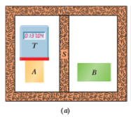
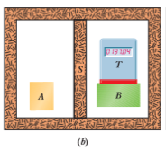
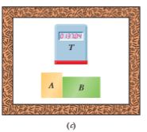
The Zeroth Law of Thermodynamics:
Suppose that, as in following Fig (a) , we put a thermoscope (which we shall call body T) into intimate contact with another body (body A).The entire system is confined within a thick-walled insulating box.
“If bodies A and B are each in thermal equilibrium with a third body T, then A and B are in thermal equilibrium with each other.”
In less formal language, the message of the zeroth law is: “Every body has a property called temperature. When two bodies are in thermal equilibrium, their temperatures are equal. And vice versa.”

Slide 3
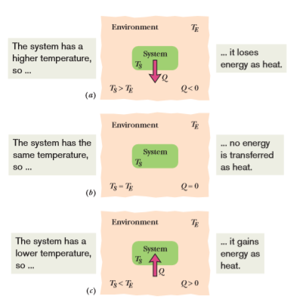
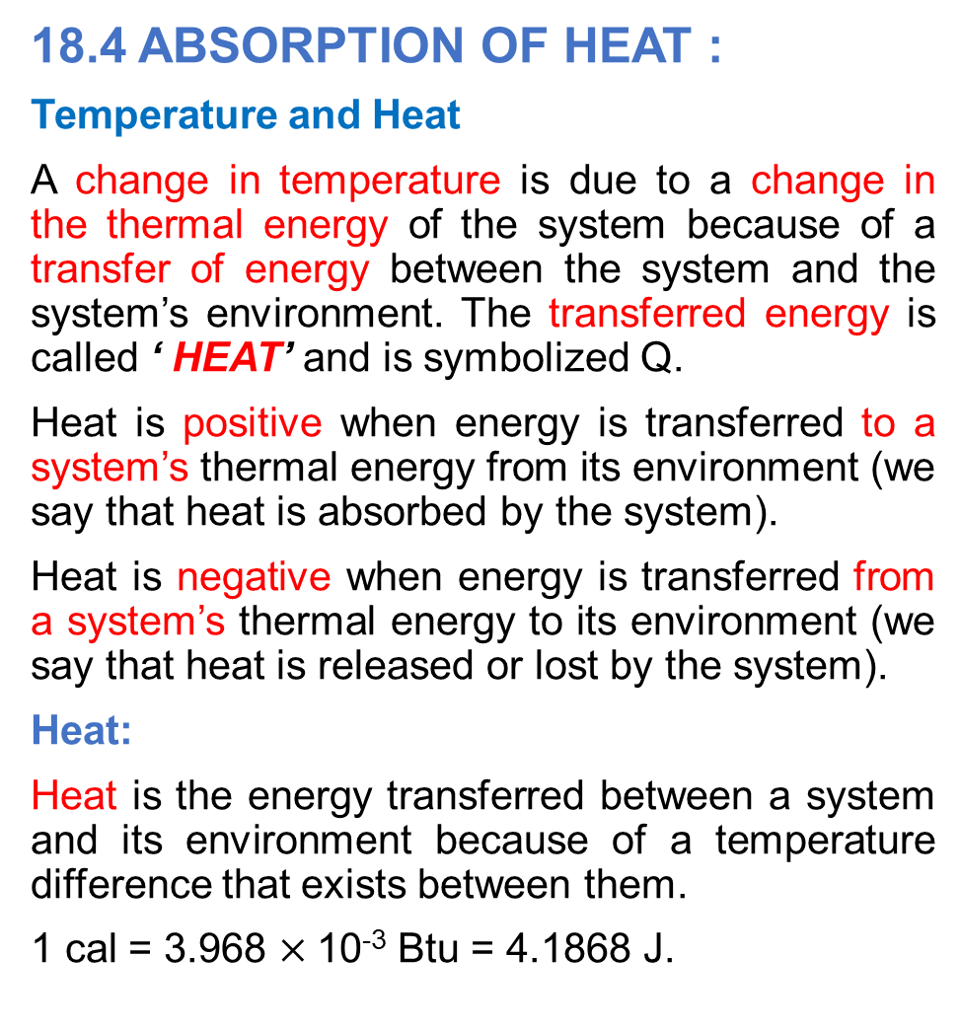
18.4 ABSORPTION OF HEAT :
Temperature and Heat
A change in temperature is due to a change in the thermal energy of the system because of a transfer of energy between the system and the system’s environment. The transferred energy is called ‘ HEAT’ and is symbolized Q.
Heat is positive when energy is transferred to a system’s thermal energy from its environment (we say that heat is absorbed by the system).
Heat is negative when energy is transferred from a system’s thermal energy to its environment (we say that heat is released or lost by the system).
Heat:
Heat is the energy transferred between a system and its environment because of a temperature difference that exists between them.
1 cal = 3.968 $×$10⁻³ Btu = 4.1868 J.

Slide 4
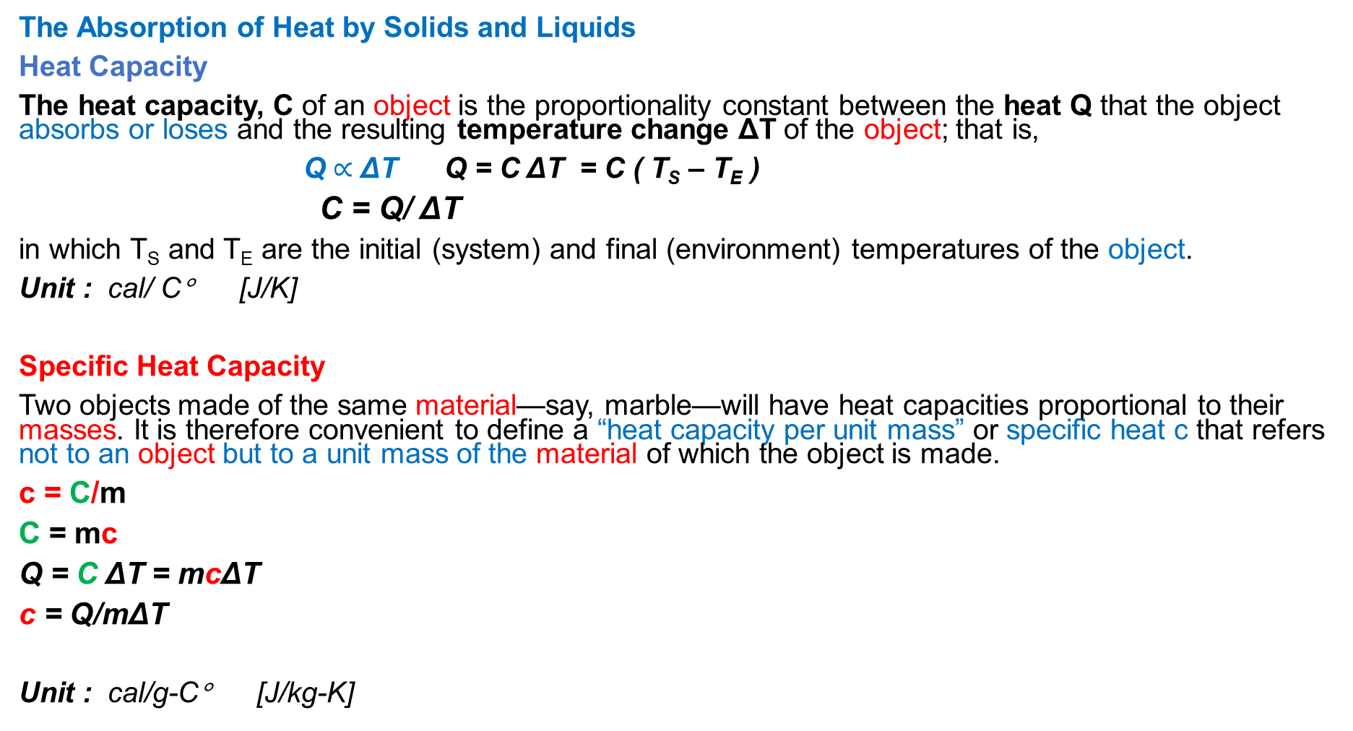
The Absorption of Heat by Solids and Liquids
Heat Capacity
The heat capacity, C of an object is the proportionality constant between the heat Q that the object absorbs or loses and the resulting temperature change ΔT of the object; that is,
Q $∝$ ΔT Q = C ΔT = C ( T_{S} – T_{E} )
C = Q/ ΔT
in which T_{S} and T_{E} are the initial (system) and final (environment) temperatures of the object.
Unit : cal/ C° [J/K]
Specific Heat Capacity
Two objects made of the same material—say, marble—will have heat capacities proportional to their masses. It is therefore convenient to define a “heat capacity per unit mass” or specific heat c that refers not to an object but to a unit mass of the material of which the object is made.
c = C/m
C = mc
Q = C ΔT = mcΔT
c = Q/mΔT
Unit : cal/g-C° [J/kg-K]

Slide 5
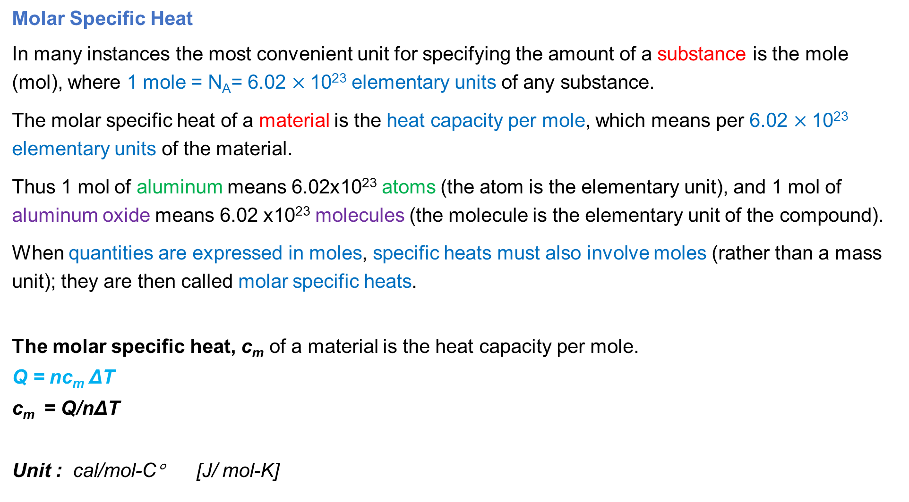
Molar Specific Heat
In many instances the most convenient unit for specifying the amount of a substance is the mole (mol), where 1 mole = N_{A}= 6.02 $×$10²³ elementary units of any substance.
The molar specific heat of a material is the heat capacity per mole, which means per 6.02 $×$10²³ elementary units of the material.
Thus 1 mol of aluminum means 6.02x10²³ atoms (the atom is the elementary unit), and 1 mol of aluminum oxide means 6.02 x10²³ molecules (the molecule is the elementary unit of the compound).
When quantities are expressed in moles, specific heats must also involve moles (rather than a mass unit); they are then called molar specific heats.
The molar specific heat, c_{m} of a material is the heat capacity per mole.
Q = nc_{m} ΔT
c_{m} = Q/nΔT
Unit : cal/mol-C° [J/ mol-K]

Slide 6
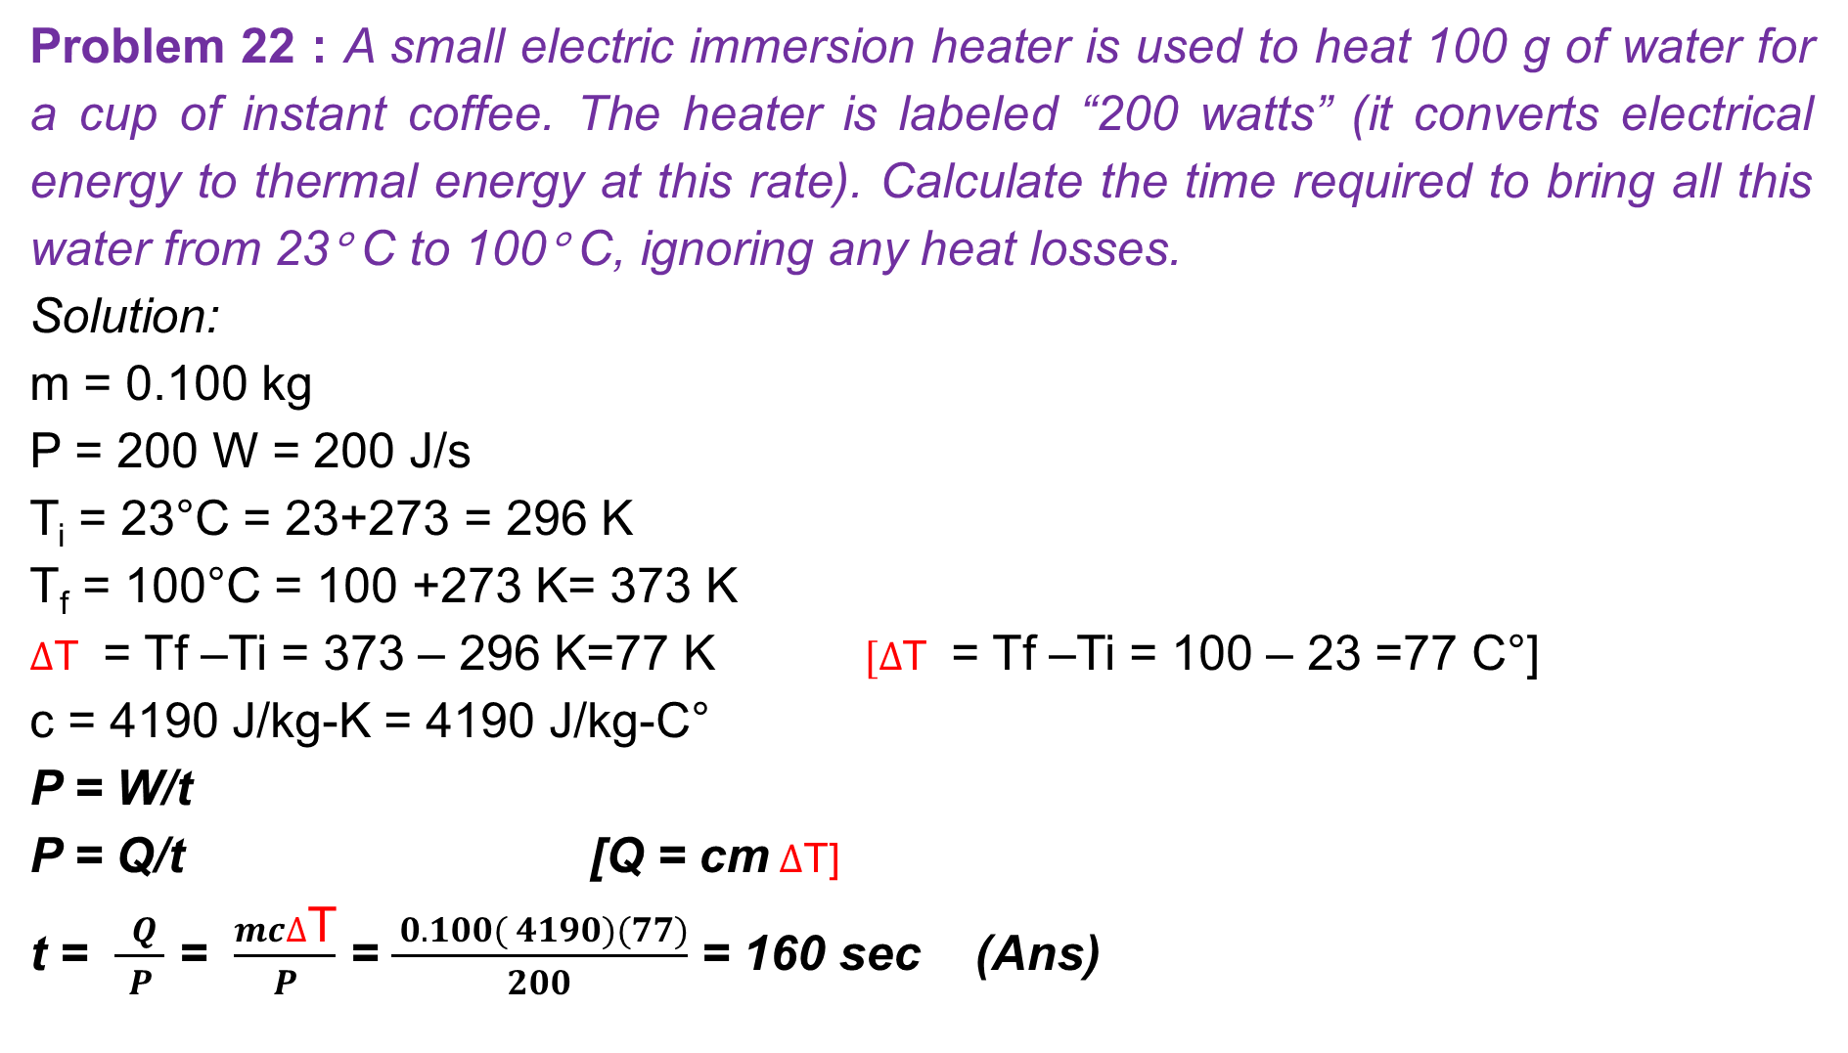
Problem 22 : A small electric immersion heater is used to heat 100 g of water for a cup of instant coffee. The heater is labeled “200 watts” (it converts electrical energy to thermal energy at this rate). Calculate the time required to bring all this water from 23° C to 100° C, ignoring any heat losses.
Solution:
m = 0.100 kg
P = 200 W = 200 J/s
T_{i} = 23°C = 23+273 = 296 K
T_{f} = 100°C = 100 +273 K= 373 K
$∆$T = Tf –Ti = 373 – 296 K=77 K $[∆$T = Tf –Ti = 100 – 23 =77 C°]
c = 4190 J/kg-K = 4190 J/kg-C°
P = W/t
P = Q/t [Q = cm $∆$T]
t = $\frac{ Q }{ P }$ = $\frac{mc∆\text{T}}{ P }$ = $\frac{ 0.100( 4190)(77)}{200}$ = 160 sec (Ans)

Slide 7
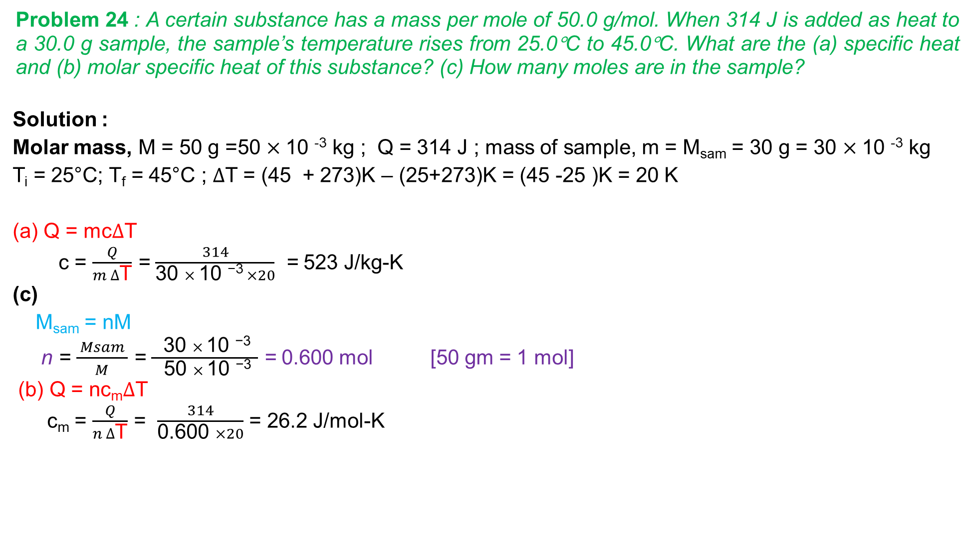
Problem 24 : A certain substance has a mass per mole of 50.0 g/mol. When 314 J is added as heat to a 30.0 g sample, the sample’s temperature rises from 25.0°C to 45.0°C. What are the (a) specific heat and (b) molar specific heat of this substance? (c) How many moles are in the sample?
Solution :
Molar mass, M = 50 g =50 $×$10 ⁻³ kg ; Q = 314 J ; mass of sample, m = M_{sam} = 30 g = 30 $×$10 ⁻³ kg
T_{i} = 25°C; T_{f} = 45°C ; $∆$T = (45 + 273)K – (25+273)K = (45 -25 )K = 20 K
(a) Q = mc$∆$T
c = $\frac{ Q }{m ∆\text{T}}$ = $\frac{ 314 }{\text{30 }× \text{10 }\text{−3} ×20}$ = 523 J/kg-K
(c)
M_{sam} = nM
n = $\frac{ Msam }{M}$ = $\frac{ \text{30 }× \text{10 }\text{−3} }{\text{ 5}\text{0 }× \text{10 }\text{−3} }$ = 0.600 mol [50 gm = 1 mol]
(b) Q = nc_{m}$∆$T
c_{m} = $\frac{ Q }{n ∆\text{T}}$ = $\frac{ 314 }{\text{0.600 }×20}$ = 26.2 J/mol-K

